Slide 1
Cuyahoga County Together We Thrive
DIVISION OF SENIOR AND ADULT SERVICES
Services and Solutions for Better Living

Slide 2
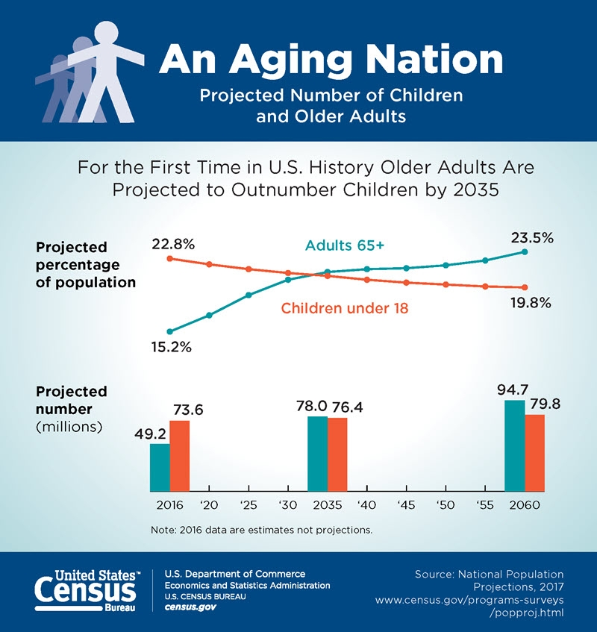
DIVISION OF SENIOR AND ADULT SERVICES

Slide 3
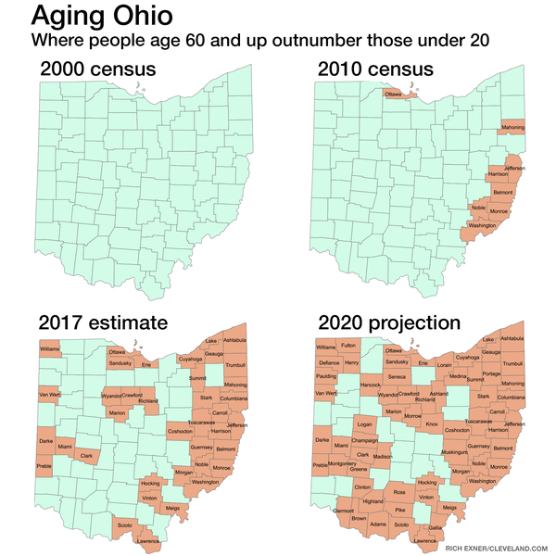
DIVISION OF SENIOR AND ADULT SERVICES

Slide 4
23.9% county residents are 60 and over
DIVISION OF SENIOR AND ADULT SERVICES
Notes:
23.9% of Cuyahoga County residents are currently over the age of 60.
301,099 people over 60 in Cuyahoga County (2014 estimate)

Slide 5
31% of county residents are projected to be 60 and over by 2030
DIVISION OF SENIOR AND ADULT SERVICES
Notes:
This number is projected to increase to 31% by 2030.
Picture: Chair exercises at Maple Heights Senior Center

Slide 6
70.9% are homeowners
DIVISION OF SENIOR AND ADULT SERVICES
Notes:
70.9% of adults age 65 + in Cuyahoga County own their home (source: Centers for Community Solutions)
They help keep vacancy rates low, maintain stable communities and pay taxes
Picture: Options client at home

Slide 7
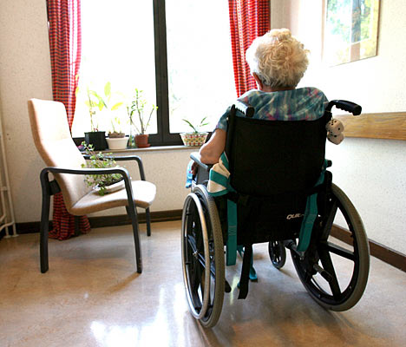
2010: 2.7% adults in Ohio had a severe disability
2020: 10.5% adults in Ohio projected to have a
severe disability
DIVISION OF SENIOR AND ADULT SERVICES
Notes:
In 2010, 2.7% of adults in Ohio had a severe disability. This number is projected to increase to 10.5% in 2020.
Beyond the economic development benefits of keeping seniors and adults with disabilities in their home, it costs less to care for a person in their home than it does in an institutional setting.
Source of statistics: 2014-2015 DSAS Strategic Plan – Executive Summary
Picture: Harvard Community Services Center (Lee/Harvard/Seville Neighborhood)

Slide 8
MISSION
The mission of DSAS is to empower seniors and adults with disabilities to age successfully by providing resources and support that preserve their independence.
DIVISION OF SENIOR AND ADULT SERVICES
Notes:
To help the adults with disabilities and seniors to live in their homes, DSAS works to provide supports to help these residents remain independent.
We are a government agency supported by the Health & Human Services levy.
We are 175 people comprised of social workers, nurses, HHAs, case managers and supportive staff dedicated to serving our community.

Slide 9
DIVISION OF SENIOR AND ADULT SERVICES
Notes:
DSAS’s budget is heavily dependent on county Health and Human Services levy dollars – 90% of its $20 million budget is from levy dollars.
Increase in APS cases and increased investment from state of $1.5 million - increasing each county from $31,000 to $48,000. We are fortunate in Cuyahoga County that our local government ha invested $4.5 millions into our APS work to investigate allegations of abuse, neglect and financial exploitation,
You’ve probably read about anticipated deficits to the levy of $15 million dollars. It’s vital that Cuyahoga County residents continue to support services to older adults and adults with disabilities by continuing to vote for the levy.
One of the most important things you can do to support older adults and adults with disabilities in Cuyahoga County is to vote for the upcoming County Health and Human Services Levy and be counted during the upcoming US Census.

Slide 10
SERVICES AND SOLUTIONS FOR BETTER LIVING
Programs and Services
1. Adult Protective Services (APS)
2. Centralized Intake (One Call Does it All – 216-420-6700)
3. Senior Center Funding
4. Options for Independent Living
5. Home Support Services
DIVISION OF SENIOR AND ADULT SERVICES
Notes:
During this presentation, I will discuss:
APS = DSAS is mandated by Ohio Law to investigate allegations
How we offer multiple programs/services to help clients stay in their homes
How we help seniors and caregivers to identify additional benefits they may be eligible for
How DSAS funds centers to provide community based services to seniors and adults with disabilities
How our Office on Aging plans, advocates and engages the community

Slide 11
National Data On Elder Abuse
1 in 10
About 1 in 10 Americans age 60+ have experienced abuse
1 in 14
Only 1 in14 cases of elder abuse ever comes to the attention of authorities
$2.9 Billion
Most recent study estimates elder abuse costs victims $2.9 billion in losses
Source: National Center for Elder Abuse Fact Sheet 2019
DIVISION OF SENIOR AND ADULT SERVICES

Slide 12
ADULT PROTECTIVE SERVICES (APS)
DSAS mandated to investigate allegations of abuse, neglect, self neglect, and/or financial exploitation of adults 60+ in Cuyahoga County
Allegations of abuse concerning adults 18+ are investigated on a voluntary basis
All calls are confidential. Referrals are made by calling Centralized Intake (216) 420 -6700.
DIVISION OF SENIOR AND ADULT SERVICES
Notes:
18+ voluntary basis means the adult has to agree to the investigation and interventions.
DSAS has no legal mandate for 18 to 59 regardless of capacity. If a client has a developmental disability, the County BDD will step in.
In Cuyahoga County, it is estimated that 26,905 older adults are victims of elder abuse. But that due to a lack awareness, most cases go unreported.
In 2014, DSAS investigated 2,177 cases with 3,900 allegations

Slide 13
2018 Federal Poverty Guidelines
Federal Poverty Guidelines | Families USA
https://familiesusa.org/product/federal-poverty-guidelines
Household/ Family Size | 100% | 300%
1 | $12,140 | $36,420
2 | $16,460 | $49,380
3 | $20,780 | $62,340
4 | $25,100 | $75,300
DIVISION OF SENIOR AND ADULT SERVICES
Notes:
During this presentation, I will discuss:

Slide 14
CUYAHOGA OPTIONS FOR INDEPENDENT LIVING (Options)
Fills a gap in Cuyahoga County by assisting older citizens to live and function independently in their own homes
Subsidizes the cost of the client’s service package
Offers sliding scale co-payment for clients
DIVISION OF SENIOR AND ADULT SERVICES
Notes:
Allows seniors who do not qualify for PASSPORT to receive affordable services in the community.
Subsidizes the cost of the client’s service package so that it becomes affordable for the client to receive services in their home
Enables seniors to remain in their own home, with as much independence as possible.
Case management provides resource information and social work for clients to make it easier to navigate the social service system and access needed services.

Slide 15
OPTIONS FOR INDEPENDENT LIVING SERVICES
Homemaking
Personal Care
Emergency Response
Home Delivered Meals
Medical Transportation
Chore
Grab Bars
Case Management (provided by DSAS Social Worker)
DIVISION OF SENIOR AND ADULT SERVICES
Notes:
Age 18+ and a resident of Cuyahoga County
Live in private home or apartment
Be physically limited enough to have difficulty doing one’s own housework, or bathing, or cooking, etc.
Walk with a cane
Limited sight
Short of breath
Help in-and-out of tub
OR
Need bathing, dressing or hygiene assistance and NOT be eligible for PASSPORT
Meet financial eligibility
Clients pay a portion of their care plan on a sliding scale
Financial eligibility
300% of poverty index ($2,943 per month single; $3,983 for couple)
Less than $35,000 in assets excluding home and/or car
Income up to 300% of poverty, currently $3,123 per month.
Assets up to $35,000 per person (including checking, savings, CD’s, IRA’s. stocks, bonds, cash life insurance value, etc.)
Excludes home of current residence and one car
Financial documentation is required.
____________________________________________________
The fee is based on a sliding fee scale.
Most Options consumers pay a co-pay starting at 1% of their service usage, gradually increasing to 30% of the client’s usage, depending on their income

Slide 16
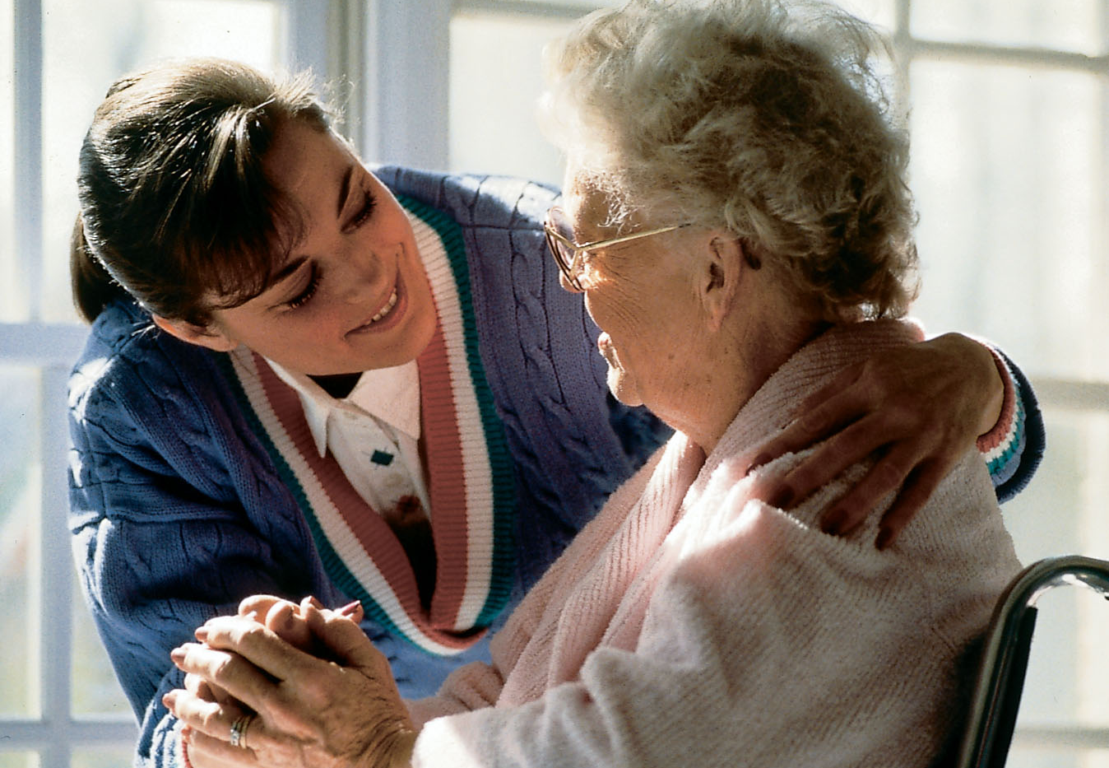
HOME SUPPORT SERVICES
Personal Care
Homemaking
Skilled Nursing
DIVISION OF SENIOR AND ADULT SERVICES
Notes:
Home Support delivers service to over 500 clients per year. (2014: 518)
Personal Care: Providing assistance with basic Activities of Daily Living (ADLs), including bathing, getting in/out of bed, dressing, meal prep and feeding.
Home Making: Providing light housekeeping for those unable to maintain a clean home, such as sweeping, laundry, making the bed, taking out the garbage, cleaning the kitchen/bathroom.
Nursing: medication management, wound care, chronic disease management
Therapy: physical, occupational, speech therapy delivered by 3rd party contractor
Picture: DSAS HHA doing light housekeeping in client’s home.

Slide 17
HOME SUPPORT SERVICES
Private Pay
Multiple Sclerosis Society
Ryan White
Medicare/Medicaid
DIVISION OF SENIOR AND ADULT SERVICES
Notes:
Private Pay: Clients pay per hour on an income based sliding fee scale. Pay hourly rate based on a sliding fee scale as low as $9.00/hr for 80% of poverty index, up to $18 for 300%
MS Society: Clients with Multiple Sclerosis can receive a stipend from the National MS Society to fund some of there care. After this is exhausted, they have the option of paying according to a sliding fee scale.
Ryan White: Clients living with HIV or AIDS who need home care are eligible to have their home care covered via the Ryan White Part A grant program; requires physician’s statement; RW grant eligibility guidelines
Medicare/Medicaid: Clients with Medicare and/or Medicaid may have PT/OT, nursing and services covered. (i.e. PT/OT, nursing, HHA and SW); requires physician’s order; medical necessity or homebound status; compliance with state & federal regulations
Picture: DSAS nurse checking & filling meds in a client’s home

Slide 18
INFORMATION SERVICES
Provides case management assistance to seniors and disabled adults to address complex needs and navigate available community resources:
Property Tax Discounts
Nutrition Programs
Senior Employment Services
Legal Services
Home Energy Assistance Programs (HEAP)
Bed Bug Extermination Services
Partners with the Aging and Disability Resource Network which provides services and linkages to numerous public benefits to seniors, caregivers, and persons with disabilities.
DIVISION OF SENIOR AND ADULT SERVICES
Notes:
DSAS will pay for an exterminator to kill bed bugs
Senior or adult w/disability must reside in home being exterminated
300% of poverty index ($2,943 per month single; $3,983 for couple)
Disabled as determined by SSI

Slide 19
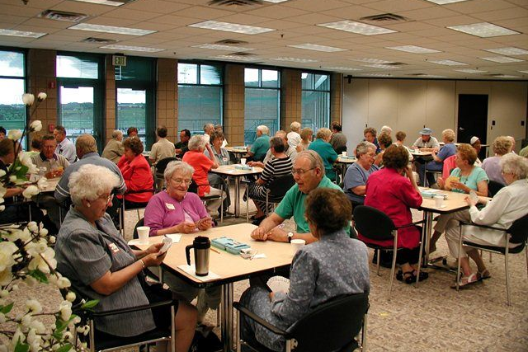
COMMUNITY SOCIAL SERVICES PROGRAM
DSAS funds 37 senior centers in Cuyahoga County
DIVISION OF SENIOR AND ADULT SERVICES
Notes:
19 centers countywide
$1.4 million in total funding per year
Services funded will vary by center
Pictures: Parma Hts (kitchen worker); Murtis Taylor – Mt. Pleasant (sewing); Lakewood (reception desk)
According to a 2018 DSAS Customer Satisfaction Survey:
85% of respondents stated they felt less lonely because of the services they received from the senior center
90% of respondents stated they felt better mentally due to the activities at the senior center
86% of respondents stated they felt better physically due to the activities at the senior center

Slide 20
COMMUNITY SOCIAL SERVICES PROGRAM
Provides funding to senior centers for services to reduce loneliness and isolation. Funded services:
Adult development services
Adult day services
Congregate meals
Transportation services
DIVISION OF SENIOR AND ADULT SERVICES
Notes:
Adult development = group senior center activities like exercise, presentations, volunteer opportunities
A study sponsored by AARP found that loneliness and social isolationism directly impacts mental and physical health
A National Institute of Health longitudinal study showed that loneliness is a predictor of functional decline and death

Slide 21
.
Key programs that Cuyahoga County residents rely on which use U.S. Census data:
Medicaid Supplemental Nutrition Assistance Program (SNAP) or “food stamps” Medicare Part B Special Education Grants | National School Lunch Program Head Start/Early Head Start Foster Care Health Care Programs (Community, Migrant, Homeless, Public Housing)
DIVISION OF SENIOR AND ADULT SERVICES
Notes:
Everyone Counts!
We rely on federal, state, and local funding to provide critical programs and services which is calculated based on the census data. Some people may not even realize that they are benefitting from programs funded by the federal government that use census data.
This is one easy way to direct funding to our community.
As Chair of the Cuyahoga County Census Aging, I can’t say enough about the importance of every person being counted.

Slide 22
Ohio loses approximately $1,814 for every person not counted in the census.
DIVISION OF SENIOR AND ADULT SERVICES
Notes:
What impact does this have on you?
Less money spent on schools, hospitals, roads, and other vital Health & Human Services Programming
The census provides vital information to state officials for the purpose of addressing population shifts, affects how funding is allocated to state, local and tribal governments
This number is based on what was distributed per person from the 2010 Census
We need everyone to be counted so we get our fair share of federal funding.

Slide 23
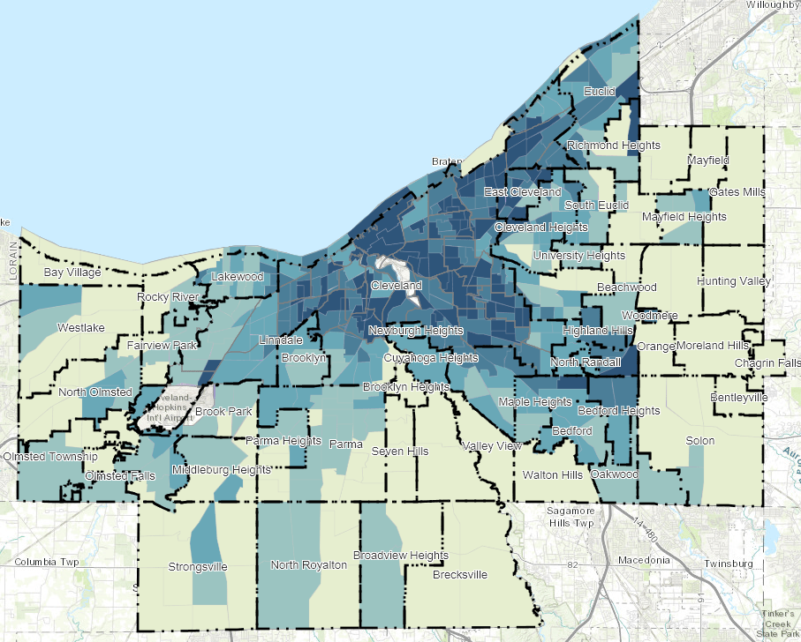
Hard to Count – Low Response Rate
DIVISION OF SENIOR AND ADULT SERVICES
Notes:
This map is a depiction of “Low Response Scores”, essentially the predicted non-response rate for the 2020 Census.
The Darker the area on the map the lower the past and predicted response rate. We need to identify strategies to work collectively to reach individuals living in those areas.

Slide 24
CONTACT INFORMATION
Tracey N. Mason, Administrator
Cuyahoga County, Division of Senior & Adult Services
Tracey.Mason@jfs.ohio.gov
(216) 420-6755

