Slide 1
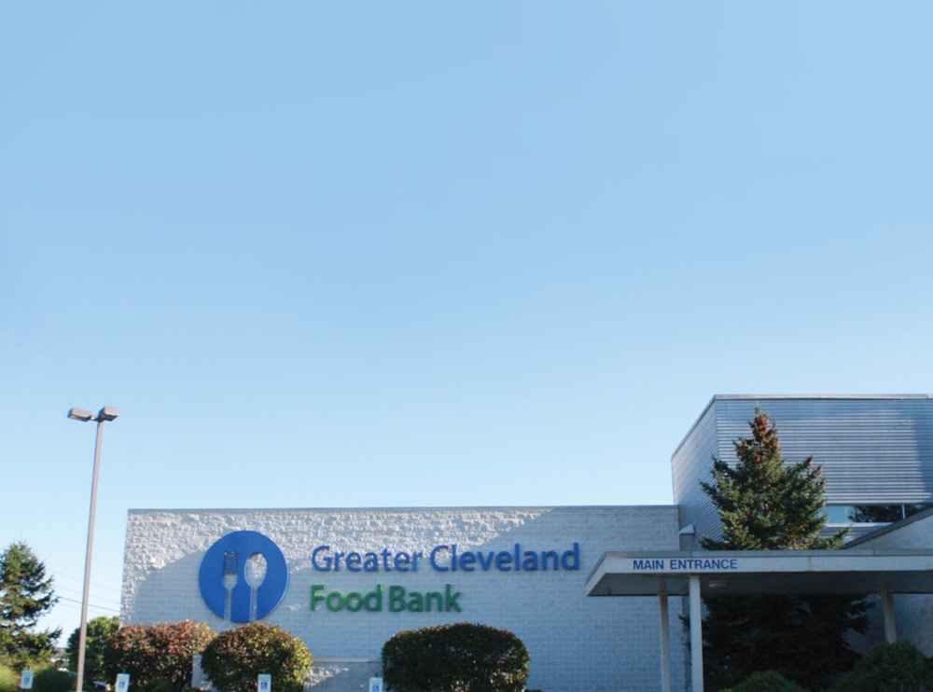
Food Insecurity, Chronic Disease and Population Health

Slide 2
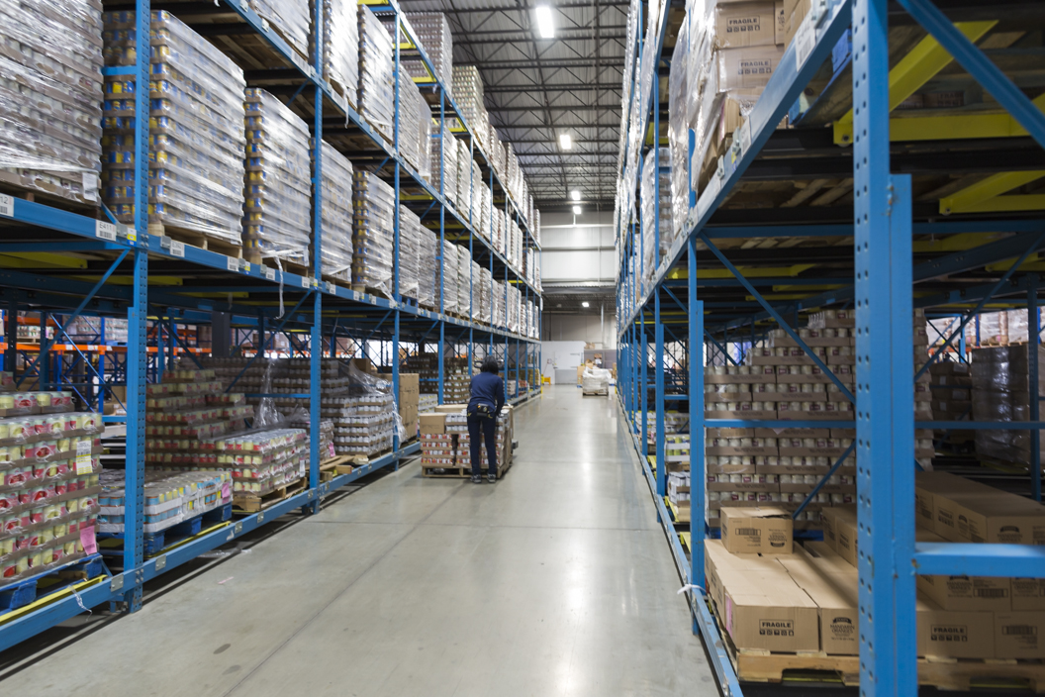
Our History
& Mission
The Greater Cleveland Food Bank was founded in 1979.
We work to ensure that everyone in our communities has the nutritious food they need every day.
Notes:
We have over 800 member agencies/community partners in Ashland, Ashtabula, Cuyahoga, Geauga, Lake and Richland counties.

Slide 3




How We Work in the Community
DONATED FOOD AND MONEY
GREATER CLEVELAND FOOD BANK
PARTNER PROGRAMS
FOOD INSECURE NORTHEAST OHIOANS
Food is donated by retailers, manufacturers, and food drives, or acquired through state and federal nutrition programs. Money and food are also donated by businesses and individuals.
Once donations arrive at the Food Bank, volunteers sort, repackage, or prepare the food to be distributed to the community.
Local churches, community centers, schools, and other organizations partner with the Food Bank and order bulk food from our warehouse to have delivered to their location.
Agencies distribute food and/or serve prepared meals to hungry people in their communities. Nearly half of these clients are children or seniors.
Notes:
1) What is percent food break down?
2) How many volunteers?
3) Between 800-900 partner programs and agencies
4) Almost 310,000 FI in our service area
57MM pounds in 2018

Slide 4
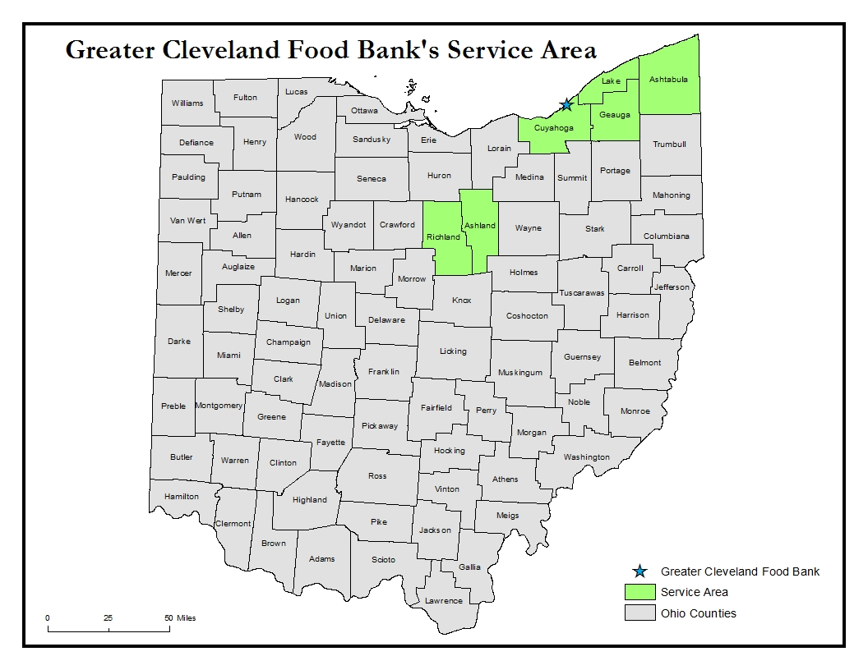
*Data based on Gundersen, C., A. Dewey, A. Crumbaugh, M. Kato & E. Engelhard. Map the Meal Gap 2018: A Report on County and Congressional District Food Insecurity and County Food Cost in the United States in 2016. Feeding America, 2018.
Notes:
About 25% of food insecure individuals in our service area are children

Slide 5
Our Network of 900+ Member Agencies and Programs
School Markets
29
Hot Meals & Shelters
132
Pantries
230
Senior Markets
21
Mobile Pantries
145
Kids Café
101
Summer Feeding Programs
107
BackPack
Programs
53
Food as Medicine Sites
10
Notes:
In FY2017 we provided food through more than 1,400 separate mobile pantry distributions in our 6 counties.
Program numbers reflect the FY2017 dashboard. Numbers for pantries and hot meals/shelters are from FY2016, and will be updated in December for FY2017.
Adult programs: 47
CSFP: 19 (1,481 seniors served in FY2017)
Hot meals: 119+shelters13
Other Children’s programs: 22 (day care, youth rehab, youth shelters)
PDO: 2
Home delivered senior meals: 3
Senior pantries: 3
Senior community meals: 8
We partner with large organizations to reach as many people as possible, such as Salvation Army, Cleveland Public Library, Hunger Network, Catholic Charities and St. Vincent de Paul, Boys and Girls Club, The Rose Centers, and many more.
Our children’s programs served more than 22,000 children in FY2017.

Slide 6
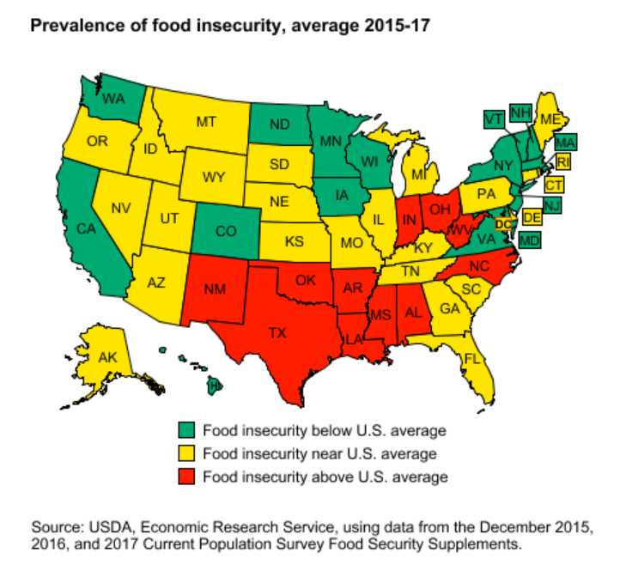
The USDA defines food insecurity as limited or uncertain access to enough food for all members of a household to live an active, healthy life
Includes quality and quantity
40 Million Americans, 5 M Seniors
More than 308,000 in our service area, including 83,460 children
Food insecurity in our service area is 14% higher than the national average
Cuyahoga County is 23% higher, at almost 1/5 individuals
Highest FI demographic is single moms with children (1/3)
Notes:
A household is defined as food insecure if, at times during the year, they were uncertain of having, or unable to acquire, enough food to meet the needs of all their members because they had insufficient money or other resources for food.
FOOD INSECURITY is the lack of access to enough food for a healthy, active life
Also, according to recent data from the USDA, Ohio also had the 3rd highest rate of very low food security, with 7.5% of households classified as very low food secure (reporting at least 6 symptoms of food insecurity).

Slide 7
Food insecurity is not synonymous with poverty
Food Insecurity
Poverty
58% of food insecure individuals are above the federal poverty level
61% of individuals living in poverty are food insecure
Ohioans are eligible for emergency food assistance if their income is less than 200 percent of federal poverty guidelines, and eligible for SNAP if at or below 130 percent of federal poverty guidelines
Notes:
Not everyone who is poor is food insecure, and not everyone who is food insecure is poor.
TEFAP is The Emergency Food Assistance Program
Commodity Supplemental Food Program (CSFP) for seniors 60+ and at or below 130%
SNAP eligibility is at or below 130% of the federal poverty level on Ohio
For a 4-person household, current poverty guidelines are $24,600, 130% is 31,980 and 200% is 49,200
WIC is below 185% of poverty, and serves 53% of all infants born in the US

Slide 8



Food Insecurity results in and from difficult choices
Research from Feeding America has shown that food insecure individuals struggle with competing expenses
64%
65%
62%
54%
Have had to choose between paying for utilities and food
Have had to choose between paying for transportation and food
Have had to choose between paying for medicine and food
Have had to choose between paying for housing and food
78% of clients report purchasing unhealthy food to stretch their budgets
Sources: Map the Meal Gap (2014) and Hunger in America (2014)
Notes:
1/3 of households report having to make these tough choices each month
Feeding American is an umbrella organization that supports 200 food banks and 60,000 food pantries

Slide 9
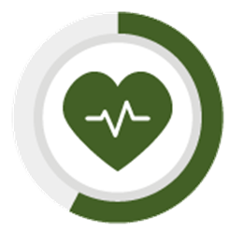
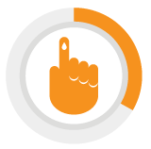
Among Food Insecure Households, Hypertension and Diabetes are most common
61%
of Households have a member with High Blood Pressure
30%
of Households have a member with Diabetes
  42.8% of clients responded they are in fair or poor health
  30% of households all members have no health insurance*
  52% of households report some medical debt
Source: Feeding America. Hunger in America 2014 – Executive Summary. Accessed at: http://www.feedingamerica.org/hunger-in-america/our-research/hunger-in-america/
*The Affordable Care Act went into effect after the fielding period of this survey
Notes:
CDC risk factors: along with smoking, drinking alcohol excessively, and poor physical activity
This research was a wake-up call to a lot of food banks that their clients were really suffering with chronic illness, and encouraged food banks, such as ours, to partner with health care providers to support

Slide 10
Food Insecurity has a strong correlation with Chronic Disease
#1 Food insecure individuals are more likely to develop a chronic disease
Hypertension - 25% +
Type II Diabetes – 25% +
Kidney disease – 50% +
Osteoporosis – 400% +
Sources:
CVD
High blood pressure 25% more common in patients with food insecurity in a nationally representative sample
Irving SM, Njai RS, Siegel PZ. Food insecurity and self-reported hypertension among Hispanic, black, and white adults in 12 states, Behavioral Risk Factor Surveillance System, 2009. Preventing chronic disease. 2014;11:E161.
Kidney disease
Food insecurity is associated with ~50% increase in kidney disease, especially in patients with diabetes and/or high blood pressure, in a national sample
Crews DC, Kuczmarski MF, Grubbs V, et al. Effect of food insecurity on chronic kidney disease in lower-income Americans. American journal of nephrology. 2014;39(1):27-35.
Osteoporosis
Food insecurity associated with 4 times the risk for osteoporosis, especially for women, in a national sample
Lyles CR, Schafer AL, Seligman HK. Income, food insecurity, and osteoporosis among older adults in the 2007-2008 National Health and Nutrition Examination Survey (NHANES). Journal of health care for the poor and underserved. Nov 2014;25(4):1530-1541.
Obesity
Adams EJ, Grummer-Strawn L, Chavez G. Food insecurity is associated with increased risk of obesity in California women. J Nutr 2003;133:1070–1074.
http://jn.nutrition.org/content/133/4/1070.short
Notes:
There is a good body of research now on the relationship between food insecurity and chronic disease. Two considerations/things to think about. First:
Key Talking Points:
Food Insecurity increases the risk that an individual will develop a chronic disease such as cardiovascular disease, diabetes, kidney disease, and osteoporosis.
Once someone has a diet-sensitive chronic disease, being food insecure makes management of that disease more difficult. Research shows that food insecure people with diabetes have increased medication non-adherence, more tradeoffs between food and medicine, poorer diabetes distress and self-efficacy, and most importantly, poor blood sugar control.
We see these challenges with other diseases, as well.
Sources
CVD
High blood pressure 25% more common in patients with food insecurity in a nationally representative sample
Irving SM, Njai RS, Siegel PZ. Food insecurity and self-reported hypertension among Hispanic, black, and white adults in 12 states, Behavioral Risk Factor Surveillance System, 2009. Preventing chronic disease. 2014;11:E161.
Kidney disease
Food insecurity is associated with ~50% increase in kidney disease, especially in patients with diabetes and/or high blood pressure, in a national sample
Crews DC, Kuczmarski MF, Grubbs V, et al. Effect of food insecurity on chronic kidney disease in lower-income Americans. American journal of nephrology. 2014;39(1):27-35.
Osteoporosis
Food insecurity associated with 4 times the risk for osteoporosis, especially for women, in a national sample
Lyles CR, Schafer AL, Seligman HK. Income, food insecurity, and osteoporosis among older adults in the 2007-2008 National Health and Nutrition Examination Survey (NHANES). Journal of health care for the poor and underserved. Nov 2014;25(4):1530-1541.
Obesity
Adams EJ, Grummer-Strawn L, Chavez G. Food insecurity is associated with increased risk of obesity in California women. J Nutr 2003;133:1070–1074.
http://jn.nutrition.org/content/133/4/1070.short
HIV
Food insecurity is associated with roughly 2 times the odds on HIV treatment non- adherence
Chen Y, Kalichman SC. Synergistic effects of food insecurity and drug use on medication adherence among people living with HIV infection. Journal of behavioral medicine. Dec 23 2014.
Singer AW, Weiser SD, McCoy SI. Does Food Insecurity Undermine Adherence to Antiretroviral Therapy? A Systematic Review. AIDS and behavior. Aug 6 2014.
Cancer
Cancer patients under active treatment had 5 times greater risk of food insecurity than state average
Gany F, Lee T, Ramirez J, et al. Do our patients have enough to eat?: Food insecurity among urban low-income cancer patients. Journal of health care for the poor and underserved. Aug 2014;25(3):1153-1168.
TB
Modeling study predicts that achieving world nutrition goals would reduce burden of TB by 20%.
Failing to address food insecurity would increase TB by 10%
Odone A, Houben RM, White RG, Lonnroth K. The effect of diabetes and undernutrition trends on reaching 2035 global tuberculosis targets. The lancet. Diabetes & endocrinology. Sep 2014;2(9):754-764.
Diabetes Control:
Ippolito, JPHN July 2016
Seligman, Diabetes Care 2013

Slide 11
Food Insecurity has a strong correlation with Chronic Disease
#2 Once a disease is established, food insecurity makes management more difficult
Increases the number of tough choices ($ on food, medications, transportation, etc)
Decreases medication adherence
Diabetes example:
  Reduces self-efficacy to manage disease
  Worse glycemic control
  Higher rate of emergency visits
Cancer patients at 5x higher risk for food insecurity
Recent research estimates that food insecurity results in $77.5 billion in additional health care costs per year ($1,863 per individual)
Sources: Gany F, Lee T, Ramirez J, et al. Do our patients have enough to eat?: Food insecurity among urban low-income cancer patients. Journal of health care for the poor and underserved. Aug 2014;25(3):1153-1168. Ippolito, JPHN July 2016, Seligman, Diabetes Care 2013
Notes:
Key Talking Points:
Food Insecurity increases the risk that an individual will develop a chronic disease such as cardiovascular disease, diabetes, kidney disease, and osteoporosis.
Once someone has a diet-sensitive chronic disease, being food insecure makes management of that disease more difficult. Research shows that food insecure people with diabetes have increased medication non-adherence, more tradeoffs between food and medicine, poorer diabetes distress and self-efficacy, and most importantly, poor blood sugar control.
We see these challenges with other diseases, as well.
Sources
CVD
High blood pressure 25% more common in patients with food insecurity in a nationally representative sample
Irving SM, Njai RS, Siegel PZ. Food insecurity and self-reported hypertension among Hispanic, black, and white adults in 12 states, Behavioral Risk Factor Surveillance System, 2009. Preventing chronic disease. 2014;11:E161.
Kidney disease
Food insecurity is associated with ~50% increase in kidney disease, especially in patients with diabetes and/or high blood pressure, in a national sample
Crews DC, Kuczmarski MF, Grubbs V, et al. Effect of food insecurity on chronic kidney disease in lower-income Americans. American journal of nephrology. 2014;39(1):27-35.
Osteoporosis
Food insecurity associated with 4 times the risk for osteoporosis, especially for women, in a national sample
Lyles CR, Schafer AL, Seligman HK. Income, food insecurity, and osteoporosis among older adults in the 2007-2008 National Health and Nutrition Examination Survey (NHANES). Journal of health care for the poor and underserved. Nov 2014;25(4):1530-1541.
Obesity
Adams EJ, Grummer-Strawn L, Chavez G. Food insecurity is associated with increased risk of obesity in California women. J Nutr 2003;133:1070–1074.
http://jn.nutrition.org/content/133/4/1070.short
HIV
Food insecurity is associated with roughly 2 times the odds on HIV treatment non- adherence
Chen Y, Kalichman SC. Synergistic effects of food insecurity and drug use on medication adherence among people living with HIV infection. Journal of behavioral medicine. Dec 23 2014.
Singer AW, Weiser SD, McCoy SI. Does Food Insecurity Undermine Adherence to Antiretroviral Therapy? A Systematic Review. AIDS and behavior. Aug 6 2014.
Cancer
Cancer patients under active treatment had 5 times greater risk of food insecurity than state average
Gany F, Lee T, Ramirez J, et al. Do our patients have enough to eat?: Food insecurity among urban low-income cancer patients. Journal of health care for the poor and underserved. Aug 2014;25(3):1153-1168.
TB
Modeling study predicts that achieving world nutrition goals would reduce burden of TB by 20%.
Failing to address food insecurity would increase TB by 10%
Odone A, Houben RM, White RG, Lonnroth K. The effect of diabetes and undernutrition trends on reaching 2035 global tuberculosis targets. The lancet. Diabetes & endocrinology. Sep 2014;2(9):754-764.
Diabetes Control:
Ippolito, JPHN July 2016
Seligman, Diabetes Care 2013

Slide 12
Food Insecurity in Seniors
Notes:
CDC risk factors: along with smoking, drinking alcohol excessively, and poor physical activity

Slide 13
Senior Food Insecurity
Nationally, 8% of seniors (age 60+) are food insecure, meaning they worried about whether their food would run out or didn’t have enough money to purchase the type food they needed.
Food insecurity is more than twice as high among black (17%) and Hispanic (16%) seniors compared to white seniors (6.5%).
Food insecurity among seniors grows to nearly 16% when there is a grandchild living in the same household.
Ohio had the same senior food insecurity rate as the nation (8%), while Cleveland’s food insecurity was at 9.5%.
The rate of hunger among seniors aged 60 and older has increased by 45% since 2001, a lingering effect of the 2008-09 recession
Source: Feeding America, The State of Senior Hunger in America in 2017
Notes:
A household is defined as food insecure if, at times during the year, they were uncertain of having, or unable to acquire, enough food to meet the needs of all their members because they had insufficient money or other resources for food.
Nationally, 13% of total Americans are food insecure

Slide 14
Senior Food Insecurity & Health Outcomes
Increase in Likelihood of Poor Health Outcomes for Food Insecure Seniors
Source: Feeding America, analysis of National Health and Nutrition Examination Survey Data (1999-2014), 2017
Notes:
A national report by Feeding America and NFESH analyzed 15 years of data from the Centers for Disease Control and Prevention, in order to better understand the effects of food insecurity on the senior population. This graph shows health outcomes related to food insecurity.
Other findings worth noting:
Food insecure seniors consumed 34% less vitamin C, 32% less vitamin A, and 17% less vitamin B6 than food secure seniors.
Vitamin C: As people age, their immune system gradually slows down. Due to its function as an antioxidant and its role in immune function, vitamin C has been promoted as a means to help prevent and/or treat numerous health conditions. The best sources of Vitamin C are fruits and vegetables, especially citrus fruits, tomatoes, red and green peppers. (https://ods.od.nih.gov/factsheets/VitaminC-HealthProfessional/#h6)
Vitamin A: Vitamin A is essential for maintaining healthy teeth, skeletal and soft tissue, and skin. It is promotes good vision, especially in low-light. Seniors who do not get enough Vitamin A are at an increased risk for eye problems and dry, scaly skin. The best sources of Vitamin A include eggs, meat, milk, orange/yellow vegetables and fruits, and spinach. (https://medlineplus.gov/ency/article/002400.htm)
Vitamin B6: Vitamin B6 helps the body to make antibodies to fight many diseases. It also maintains normal nerve function and keep blood sugar in normal ranges, which is essential to the older population. The best sources of B6 include meat, fish, legumes, bananas, and potatoes. (https://medlineplus.gov/ency/article/002402.htm)
Food insecure seniors are 2.3 times more likely to experience depression than their food secure counterparts. (230%!!!!)
Households living with grandchildren are almost three times as likely to be food insecure as households without grandchildren.

Slide 15
The obesity rate among seniors with incomes below $25,000 was
39% higher than for seniors with incomes of $75,000 or more.
Notes:
https://assets.americashealthrankings.org/app/uploads/ahr2017_seniorreport.pdf

Slide 16
Seniors with incomes of more than $75,000 were 135% more likely to report very good/excellent health compared to seniors with incomes below $25,000.
Notes:
https://assets.americashealthrankings.org/app/uploads/ahr2017_seniorreport.pdf

Slide 17
Rate of Diet-Related Illness in Households Served by GCFB Agencies
Health of GCFB Seniors
Three in four households with seniors (76%) had at least one member struggling with high blood pressure, compared to half of households without seniors (53%).
When it came to households with seniors, the rate of diabetes was at 39%, compared to 26% for households without seniors.
More than half of households with seniors (55%) reported choosing between paying for food and paying for medicine or medical care.
Notes:
The Greater Cleveland Food Bank serves approximately 247,000 people each year. Of these people coming to the doors of our emergency feeding programs, 16% are seniors age 60 and older. (37,000+ individuals)
In a national study conducted locally by the Food Bank, we were able to look at the health of the people seeking emergency food assistance in our six counties, including seniors. (Findings are shown on this slide.)

Slide 18
Food as Medicine Models
Notes:
CDC risk factors: along with smoking, drinking alcohol excessively, and poor physical activity

Slide 19
Screening for Food Insecurity is the Key to Intervention
Hunger Vital Sign^{TM *}
Within the past 12 months, we worried whether our food would run out before we got money to buy more
  often true sometimes true never true don’t know/refused
Within the past 12 months, the food we bought just didn’t last and we didn’t have money to get more
often true sometimes true never true don’t know/refused
* Created and validated by Children’s HealthWatch (Boston Medical Center), endorsed by American Academy of Pediatrics, American Academy of Family Physicians, and others
Best Practices
Integrated into regular intake process
Asking in writing is more effective
Asked at every visit
Coding options available for EHRs
If you don’t ask, you don’t know
Notes:
Children’s health watch is operated out of Boston Medical Center – monitors the impact of economic conditions and public policies on the health and well-being of very young children. Founded in 1998, conducts research on links between nutrition, housing, energy, etc on health
-The USDA ERS method is nice to know for understanding and interpreting the research between food insecurity and health
Sources: https://www.ers.usda.gov/topics/food-nutrition-assistance/food-security-in-the-us/survey-tools/
The USDA Economic Research Service (ERS) conducts regular food security research using longer, more detailed processes (i.e. multi-stage surveying)
Their research is cited frequently, including a differentiation between levels of food security, typically: high, marginal, low and very low
Low food security - reduced quality and variety; little indication of reduced food intake
Very low food security – disrupted eating patterns, reduced food intake, both quality and quantity of food affected

Slide 20
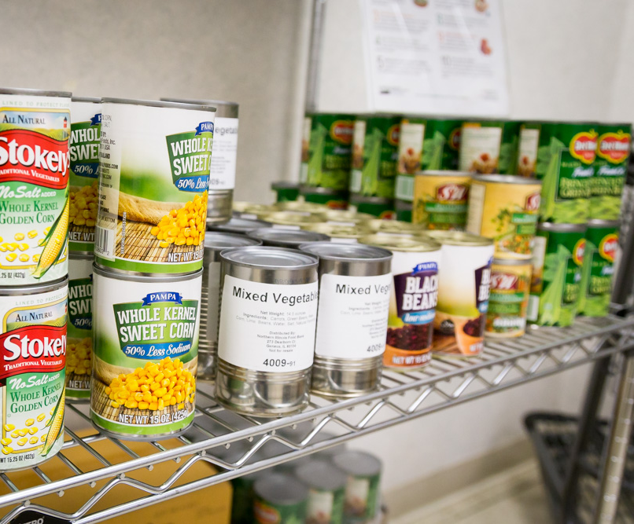
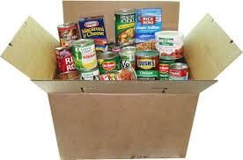
On-Site Food Resources for Food Insecure Patients Include:
Therapeutic Food Clinics: Provide nutritious and health condition-appropriate foods to food-insecure patients after a clinical referral
  Full-scale clinic: fresh, frozen, refrigerated, and shelf-stable foods
  Shelf-stable-only: canned foods, dried goods, shelf-stable milk
Examples: MetroHealth, UH Otis Moss, The Centers
Produce Distributions: A truckload of fresh produce is delivered to healthcare centers on a regular basis in areas of high need.
Examples: Metrohealth, NEON, J. Glen Smith, Stephanie Tubbs Jones, Medworks

Slide 21
Off-Site Food Resources for Food Insecure Patients Involve Referrals to our Help Center:
Nutrition Prescription Pads
Given to patients from provider
Number included is for medical referrals only, which enables us to track medical referrals and associated outcomes
Online Referral Form
Providers refer patients directly
Help Center responds to patient within 24 hours or as requested
Online referral form example
Can track referrals and evaluate patient and process outcomes
Help Center Referrals Include
Food access
Nutrition/food education
Long-term support
Notes:
At this point in time, most health

Slide 22
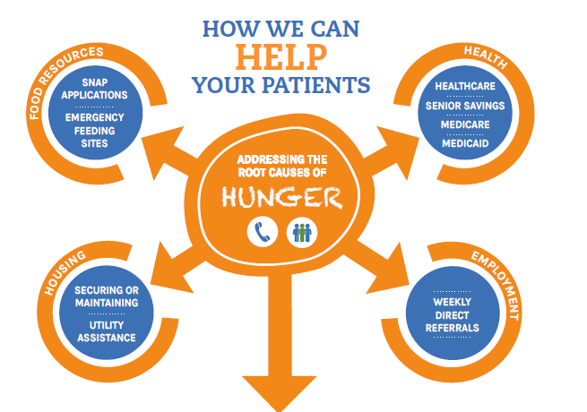
Help Center and Outreach Services:
Notes:
At this point in time, most health

Slide 23








For More Information Contact Us:
FAM@ClevelandFoodbank.org
Current Partnerships

